Slide 1

The premier performer-to-venue connection

Slide 2
Problem Definition

Slide 3
Team Members
Team Advisor
Aaron Verst
verstar@mail.uc.edu
Ryan Gengler
genglera@mail.uc.edu
Jillian Aurisano
aurisajm@ucmail.uc.edu

Slide 4
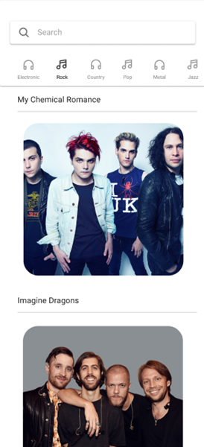
Project Abstract
Gigseek is a web-based application designed streamline and simplify the process of booking a live event. To achieve this, Gigseek equally serves both venues and performers by facilitating a space for communication between both parties on an event-by-event basis. Gigseek’s ultimate goal is to provide every aspect of the event booking process used by venues and performers under one umbrella.

Slide 5
Intellectual Merits and Broader Impacts
Some Intellectual Merits that we would like to include:
The ability to filter performers or venues based on categories such as genre and location/origin.
Providing communication between the selected performer and venue, allowing them to plan out a time and date to perform.
Filtering potential venues based off of capacity so that ticket sales can be maximized and efficient not only for the performer, but also the venue.
Some Broader Impacts that we would like to include:
Our platform offers a streamlined booking process that connects venues and performers directly, circumventing the need for booking managers.
Our platform enables performers and venues to efficiently evaluate each other, facilitating booking decisions.
Additionally, our platform allows users to research venues and performers prior to purchasing tickets.
Furthermore, our platform has the potential to assist smaller performers in building their musical portfolio and accessing gig opportunities.

Slide 6
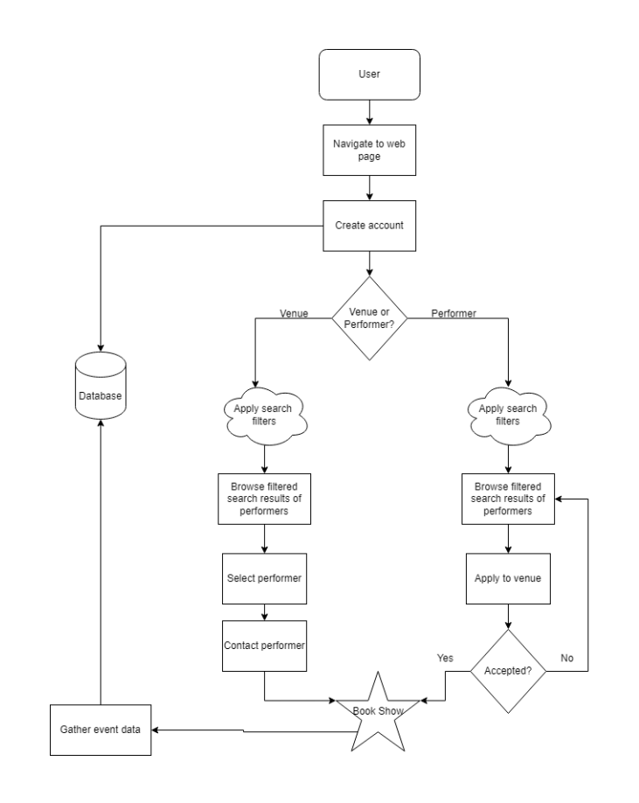
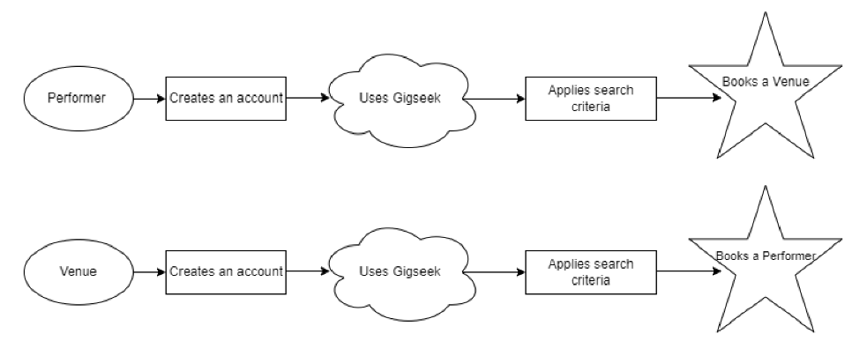
Design Diagrams
venues

Slide 7
Design Specifications
The diagram shown on the previous slide encapsulates the process of the performer’s and venue’s experiences under one diagram. After navigating to the webpage, the user is prompted with creating an account. Accounts created in this stage are then stored in the applications database.
This account can be registered as either a performer or a venue. This decision is represented by the diamond symbol. If the user is operating a performer account, they are then able to begin searching for venues they would like to perform at. They will be able to apply various search criteria (date, location, venue capacity, etc) to filter down their search results.
Once the performer finds a venue, they are then able to apply to that venue. If the venue accepts their booking, the show is booked for both parties. If the venue denies the booking, the performer account returns to the searching phase.
If the user is operating a venue account, they are able to search for performers to fill a specific date/time they have open. They are able to apply search filters (performer location, genre, etc.) to narrow down their search. If the user finds a performer that fits their criteria, they are able to book that performer for the specified date.
Once a show is agreed upon by both parties and is officially booked, the event’s data is then stored in the application’s database.

Slide 8
Technologies
One of the technologies that we will be implementing is search filtering. This will allow the user, whether they are a user, a performer, or a venue, to filter out venues and performers that are not applicable for the current user. This also helps the user find exactly the venue or performer that they are looking for in a short amount of time.
Another technology that we are implementing is the Object-Oriented Programming connection between the flat files, containing the data that we will be including in our “database” and the application itself. This will allow us to feed the application data to ensure that the functionality of our application is working as planned.
Currently, we will only be developing a web-based application based on the time frame that we have. We believe this would be much easier to port a web-based application into a mobile application instead of creating a mobile application first and trying to port a web-based application from that. Our plan is to eventually create a mobile application, but that is for our own future plans and will not be pursuing that within the semester that we have.

Slide 9
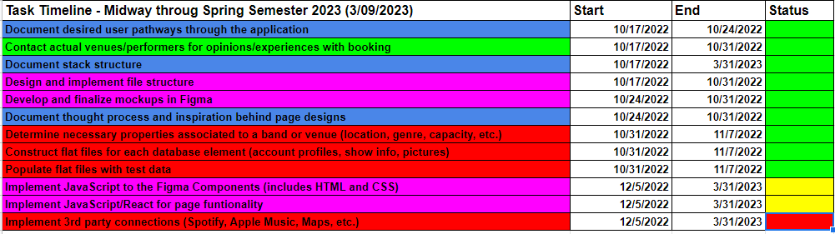
Current Project Milestones
Below is an updated version of our project timeline. Status boxes indicatie the following:
Green - Task has been completed
Yellow - Task has been started
Red - Task has not been started

Slide 10
Our Expected Demo at Expo
At the time of the demo, we will have successfully tied the frontend to the backend. Although all features might not be ready for release, this first iteration will provide us with a foundation to build upon prior to release. By reaching this goal, we will be able to effectively test and get feedback on our application and move towards the final stages of development. A goal of ours is to have our application working on a full-stack level.
At the demo, we intend to demo the full process of booking a venue/performer through Gigseek. This demo will demonstrate the primary functionality of Gigseek if it were fully released to the general public.
Furthermore, we plan on showcasing samples of additional features such as 3rd party connections and performer/venue content (photos and videos) on account profiles.

Slide 11
Results Achieved
At this current time, we have successfully completed numerous tasks. These tasks include:
Field definitions for performers and venues
Design sketches for frontend user interfaces
Defined user pathways
Creation of flat file database
Creation of homepage and numerous subsequent pages
Outstanding Tasks to be Completed:
Build object-oriented connection between static database and frontend
Build search and filtering capabilities
Build profile page that integrates data from static database and external sources(spotify).

Slide 12
Challenges
Throughout the course of our project we have faces numerous challenges that have affected both our timelines and overall goals. These challenges include:
Due to unforeseen circumstances, we permanently lost one of our team members midway through Gigseek’s development life cycle. This dramatically affected our workflow and increased workload on the two remaining team members. To overcome this, we had to modify our assigned tasks and scale down our project’s deliverables to ensure that were still able to deliver a complete application.
The biggest technical challenge that we faced was our application’s data management architecture. Originally, we had planned to incorporate a fully object-oriented database with read and write capabilities. However, due to the need to scale down our goals, we decided to implement a static database that uses flat files as a datasource. This solution allowed us save time on data management and spend more time on frontend development

